Slide 1
Noon Seminar: Progress Reporting Follow-up Dr. Heather Atkinson, Academic Adviser Melissa McBrayer, Lead Academic Adviser Shawna Culp, Academic Adviser
Website: https://starfish.psu.edu
Email: starfish@psu.edu
Updated: 2023.09.7
Notes:
[Start Recording]
I have the time as Noon, let's get started!
My name is Heather Atkinson, I am an Academic Adviser in the Division of Undergraduate Studies and Starfish Tenant Administrator. Along my fellow Academic Advisers and Starfish Tenant Administrators, Melissa Mc Brayer (Liberal Arts) and Shawna Culp(World Campus), we look forward to sharing information with you about Fall 2023 Progress Reporting.
A quick note that this presentation will be recorded.
As we move through the content, please post any questions you have for the Starfish team to QNA and use the chat to communicate to other advisers in the audience.

Slide 2
Agenda
Progress Survey Dates
Changes to Progress Reporting
Fall 2023 Survey Options
Filtering
Flags and To-Dos
Managing Tracking Items
Student Cleared To-Dos
Student Closed with Review (student view, adviser view)
Student Closed without Review (student view)
Instructor view: progress survey and student-closed To-Do with review
Documentation
Helpful Links
Future presentations
Contact
Notes:
I want to extend a Thank you to you all for joining us today. We have a full agenda so let’s dive in!
Progress Survey Dates
Changes to Progress Reporting
Fall 2023 Survey Options
Filtering
Flags and To-Dos
Managing Tracking Items
Student Cleared To-Dos
Student Closed with Review (student view, adviser view)
Student Closed without Review (student view)
Instructor view: progress survey and student-closed To-Do with review
Documentation
Helpful Links
Future presentations
Contact

Slide 3
Progress Survey Dates
Early Progress Survey: Tuesday, September 5 – Wednesday, September 13
Mid-Semester Progress Survey: Monday, October 2, to Wednesday, October 25
Pilot progress surveys for partial-semester undergraduate courses are continuing for courses delivered through Penn State Abington and the Ross and Carol Nese College of Nursing from Tuesday, September 5 – Wednesday, September 13, and Monday, October 30 – Wednesday, November 8.
Notes:
Early Progress Survey: Tuesday, September 5 – Wednesday, September 13
Mid-Semester Progress Survey: Monday, October 2, to Wednesday, October 25
Pilot progress surveys for partial-semester undergraduate courses are continuing for courses delivered through Penn State Abington and the Ross and Carol Nese College of Nursing from Tuesday, September 5 – Wednesday, September 13, and Monday, October 30 – Wednesday, November 8.
We are currently 3 days into the Early Progress Survey period. We're hoping this presentation is timely for advisers!

Slide 4
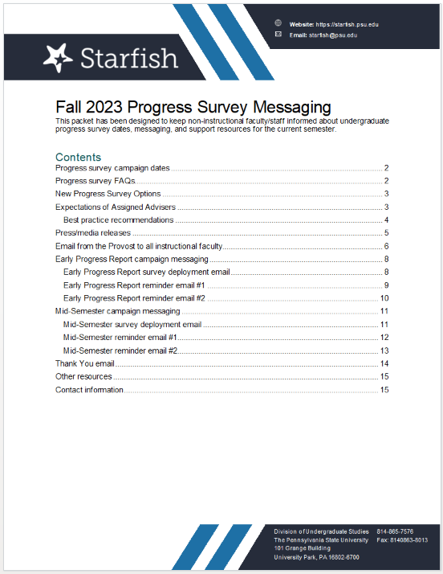
Two significant changes
Fewer flags, all focused on urgent concerns
Instructor recommendations (To-Dos) that encourage students to take action.
Why make these changes?
Feedback from advisers and students that there were too many negatives without constructive actions to take
Feedback from instructors that there was confusion about who was responsible for doing what
Shift to growth-oriented, action-oriented options
Total tracking Items: 2 kudos, 1 flag, 4 to-dos
Students can take first in action workflow!
Advisers have clearer action steps
The new survey options will refocus adviser responsibilities. Please see pages 3-4 of the Fall 2023 Progress Survey Messaging document for details and general guidance.
Notes:
Fewer flags, all focused on urgent concerns
Instructor recommendations (To-Dos) that encourage students to take action.
Click.
Why make these changes?
Feedback from advisers and students that there were too many negatives without constructive actions to take
Feedback from instructors that there was confusion about who was responsible for doing what
Shift to growth-oriented, action-oriented options
Total tracking Items: 2 kudos, 1 flag, 4 to-dos
Students can take first in action workflow!
Advisers have clearer action steps
The new survey options will refocus adviser responsibilities. Please see pages 3-4 of the Fall 2023 Progress Survey Messaging document for details and general guidance.

Slide 5
Fall 2023 Progress Survey Options
Early Progress Report (EPR)
Mid-Semester Progress Report
(Kudos) Outstanding Performance
(Kudos) Meeting Expectations
(Flag) Never addended or Logged in to course
(To-Do) Instructor's Recommendation: Participate more consistently
(To-Do) Instructor's Recommendation: Come to Office hours
(To-Do) Instructor's Recommendation: Seek tutoring
(To-Do) Instructor's Recommendation: Talk with your Adviser
(Kudos) Outstanding Performance
(Kudos) Meeting Expectations
(Flag) In danger of Earning less than a C
(To-Do) Instructor's Recommendation: Participate more consistently
(To-Do) Instructor's Recommendation: Come to Office hours
(To-Do) Instructor's Recommendation: Seek tutoring
(To-Do) Instructor's Recommendation: Talk with your Adviser
Resource: https://starfish.psu.edu/resources/messages/
Notes:
These are the 2 kudos, 1 flag, and 4 To-Dos for each Progress Survey period.
A note that each of these items are available for Instructors to raise manually/individually.
We, Starfish Tenant Admins, have seen raised Flags: In danger of earning less than a C already.

Slide 6
Filtering
Starfish filters help you focus in on specific groups of students
Five Most Important Tips for Successful Filtering
The Starfish filter is an AND filter, so will only show you students that meet ALL selected criteria
Never select a Term when using filters
Wild cards (the * symbol) can be used in string values
Filters remain ON until you clear them, even after logging out of Starfish
Be patient while the filter processes.
Resource: https://starfish.psu.edu/user-roles/advisers/using-filters
Notes:
Starfish filters help you focus in on specific groups of students
Five Most Important Tips for Successful Filtering
The Starfish filter is an AND filter, so will only show you students that meet ALL selected criteria
Never select a Term when using filters
Wild cards (the * symbol) can be used in string values
Filters remain ON until you clear them, even after logging out of Starfish
Be patient while the filter processes. Sometimes it takes a minute or two and clicking again only gives it more things to think about. If combining multiple search criteria, it’s best to stack them one at a time.

Slide 7
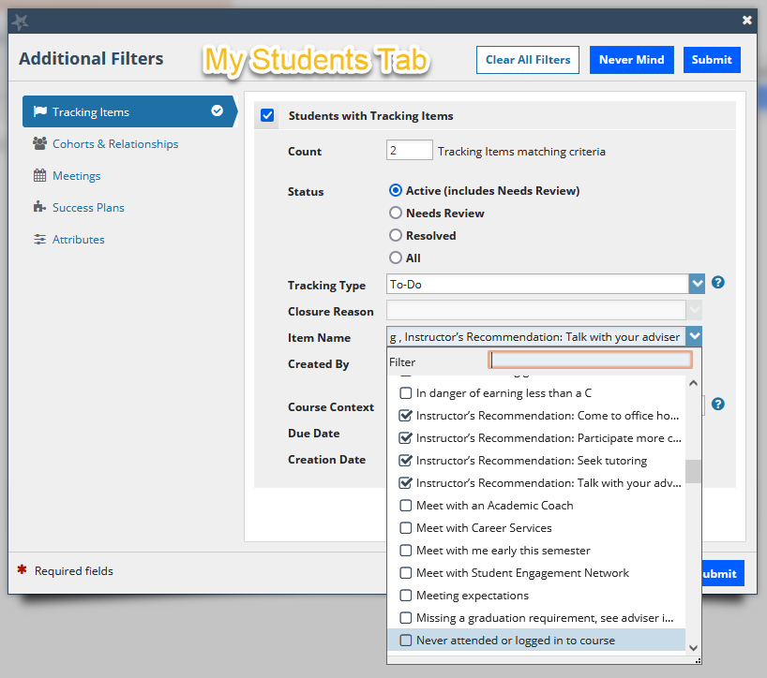
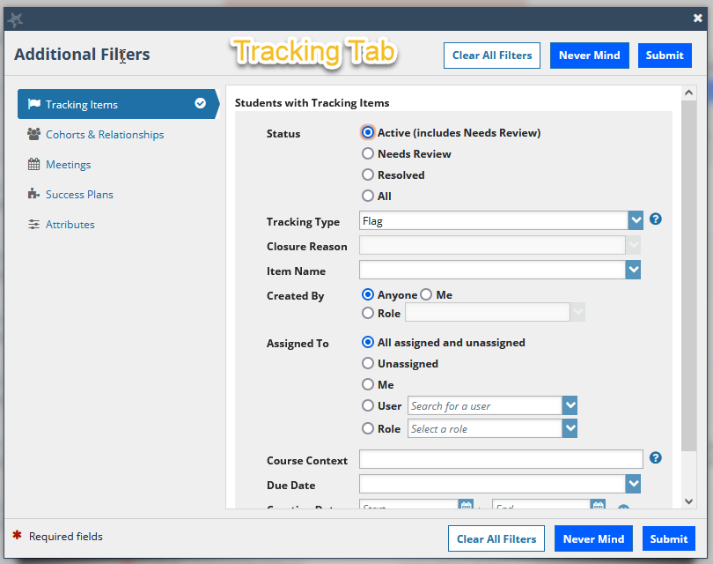
Filters
Note: The My Students tab and the Tracking tab have different filter functions.
See Example:
Resource: https://starfish.psu.edu/user-roles/advisers/using-filters
Notes:
These are the Filtering Tabs in Starfish, accessed from the Hamburger menu, then Students tab.
The Tracking tab is most commonly used for Tracking Items associated with Progress Surveys but, there are a few insider tricks for filtering with the My Students tab.
Click..
The My Students tab and the Tracking tab have different filter functions, which we will discuss through the next few slides.

Slide 8
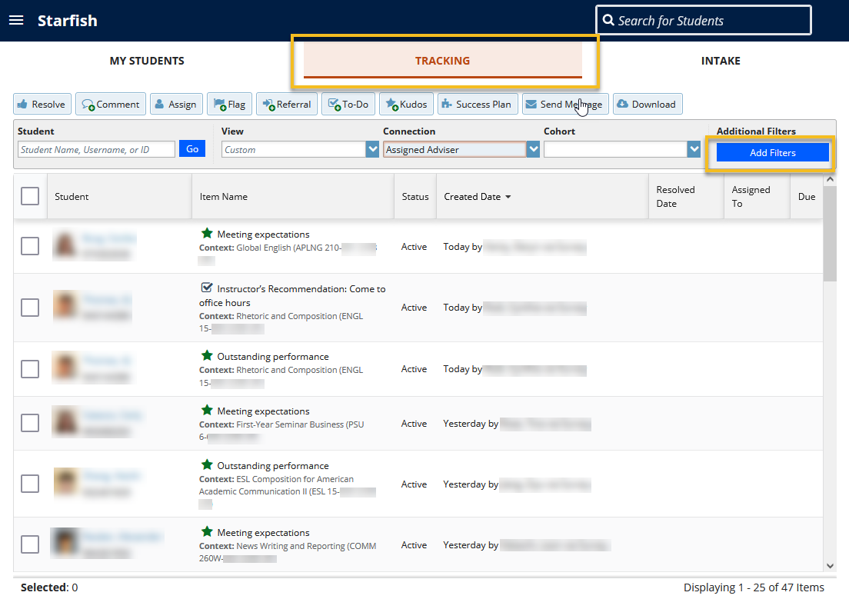
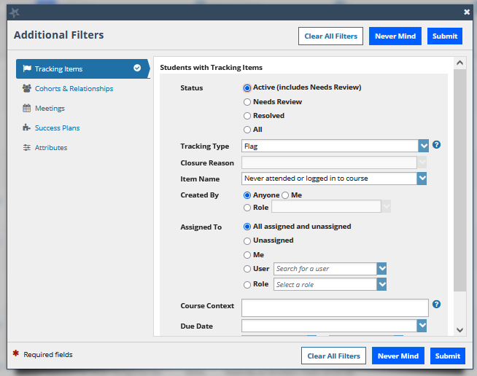
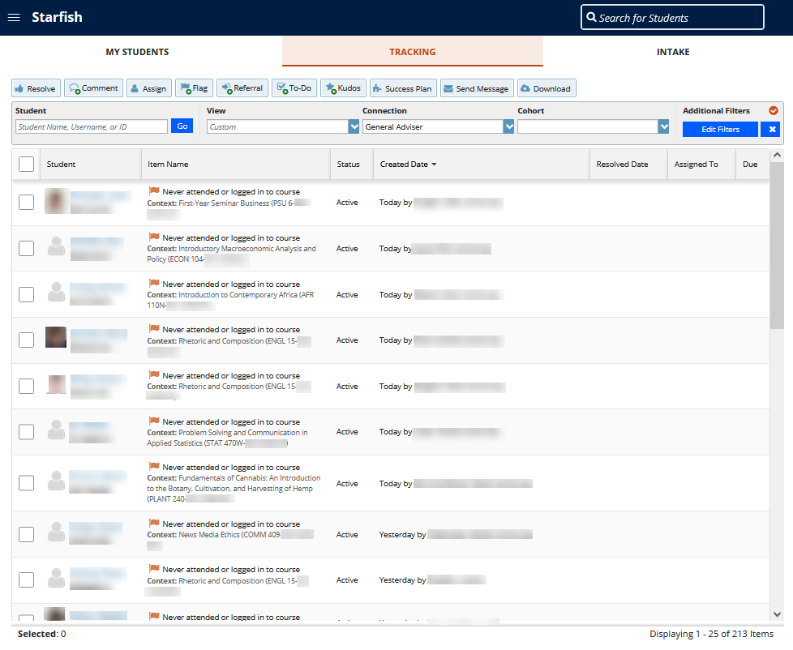
Flag(s)
(Flag) Never attended or logged in to course
One flag per course
Why is this important?
Advisers are quickly able to surmise by the number of flags, if a student has not engaged with multiple courses.
Triage quickly which students need additional attention.
Resource: https://starfish.psu.edu/resources/messages/
Notes:
Each Progress Survey has one flag per course.
Why?
Advisers are quickly able to surmise by the number of flags, if a student has not engaged with multiple courses.
Triage quickly which students need additional attention.
Click
Use the Tracking tab and Add Filters to view students who have the Flag: Never attended or logged in to course.
Best practice for advisers is taking action on these flags during the Progress Reporting period.

Slide 9
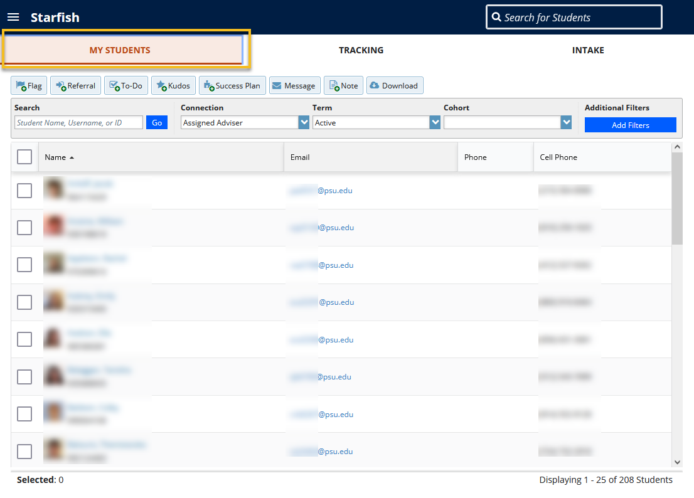
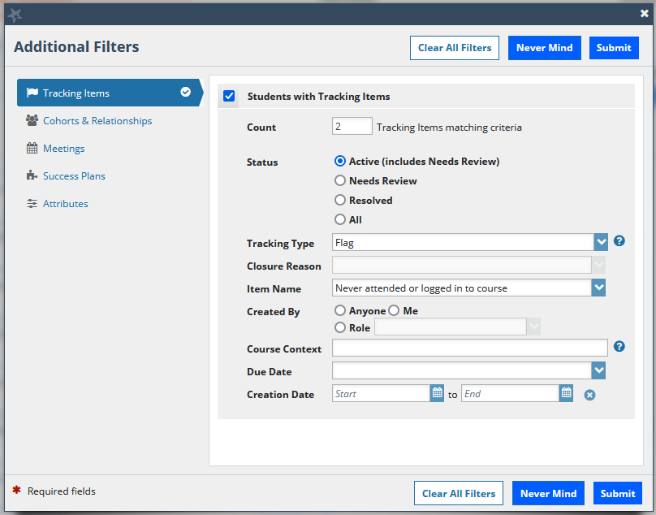
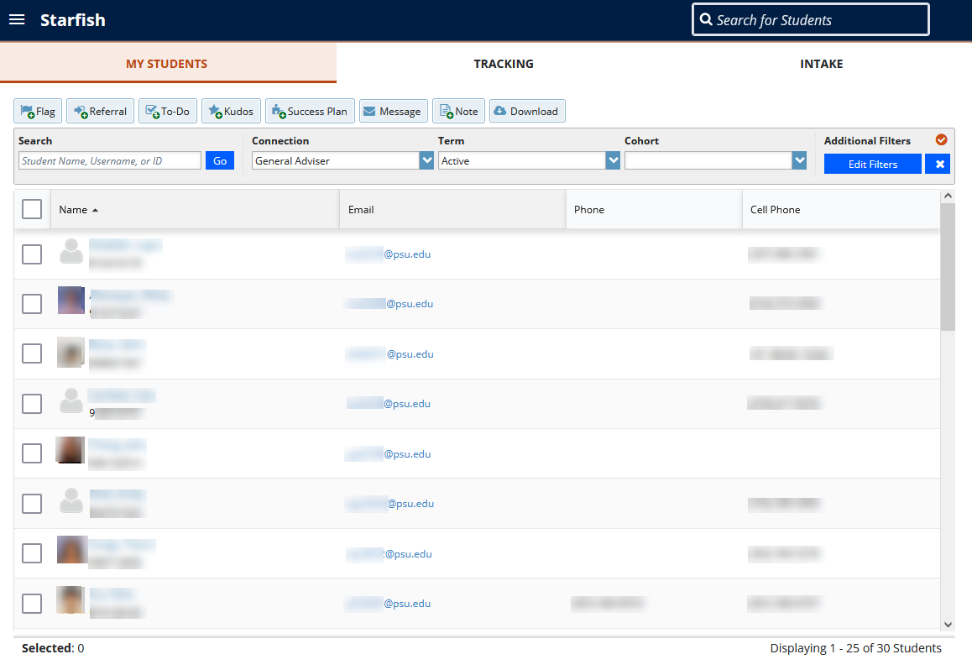
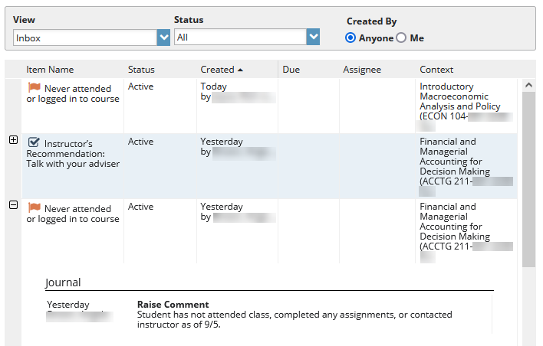
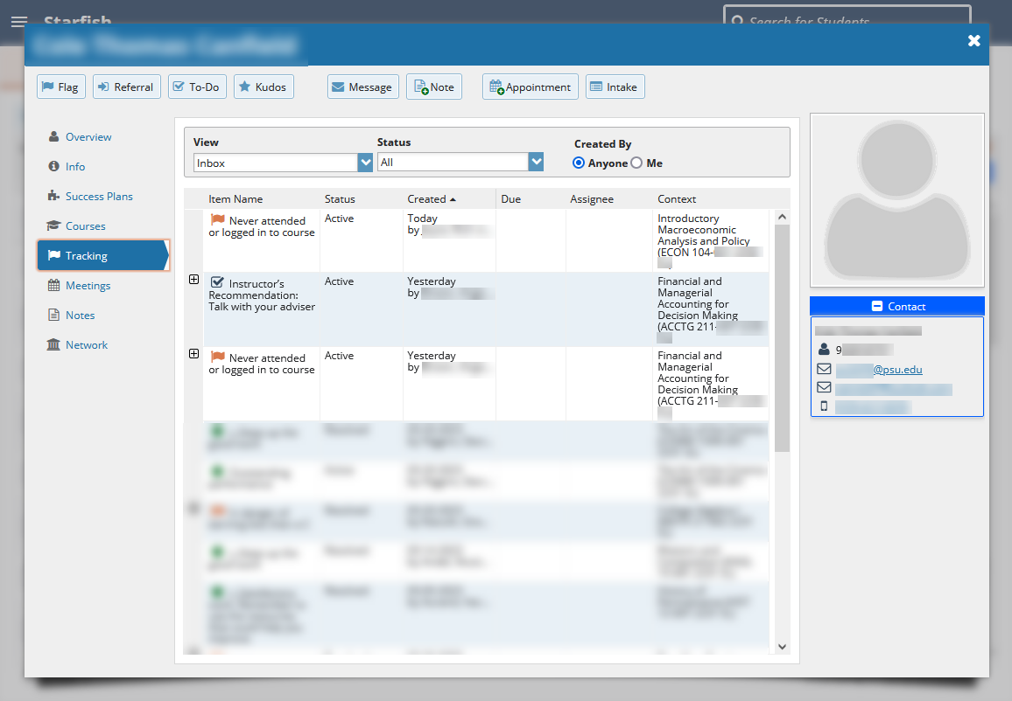
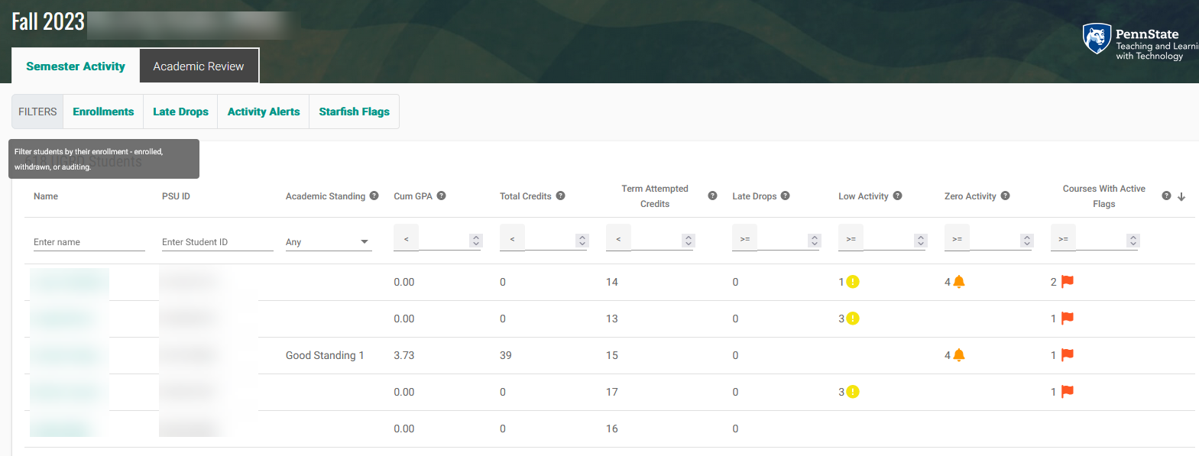
Multiple Flags
Identify students with multiple flags...Using the My Student tab
Connection: Assigned Adviser
click Edit Filters
Students with Tracking Items: click check box
Count: enter number (E.g., 1,2,3...)
Status: select Active (includes Needs Review)
Tracking Type: select Flag
Advisers can also quickly filter for multiple flags in Elevate. Use the Courses with Active Flags column.
*Note: Upcoming presentation from Elevate on October 5!
Notes:
A student with a single course flag is of concern, of course, but a student with multiple flags is of a higher concern. Best Practice for advisers is to triage these students first during the Progress Reporting period.
Click.
Adviser can identify students with multiple flags...Using the My Student tab
Connection: Assigned Adviser
click Edit Filters
Students with Tracking Items: click check box
Count: enter number (E.g., 1,2,3...)
Status: select Active (includes Needs Review)
Tracking Type: select Flag
Advisers can also quickly filter for multiple flags in Elevate. Use the Courses with Active Flags column.
*Note: Upcoming presentation from Elevate in October...

Slide 10
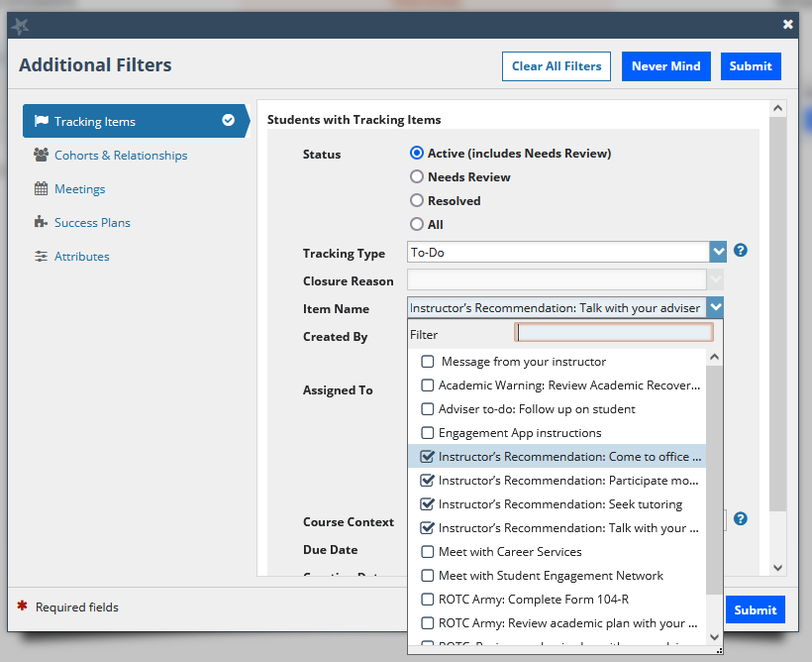
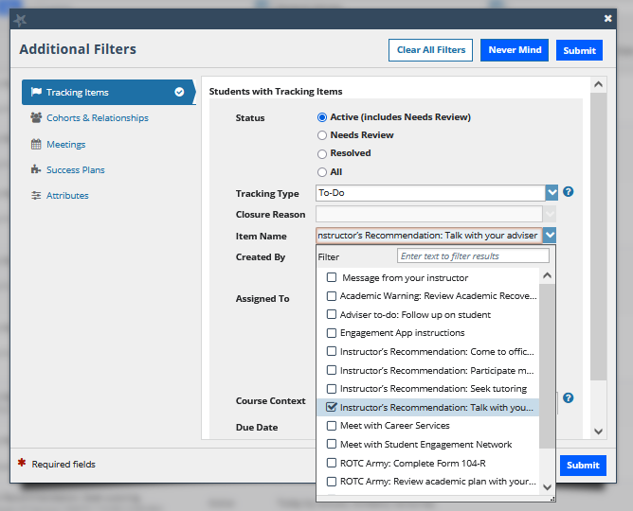
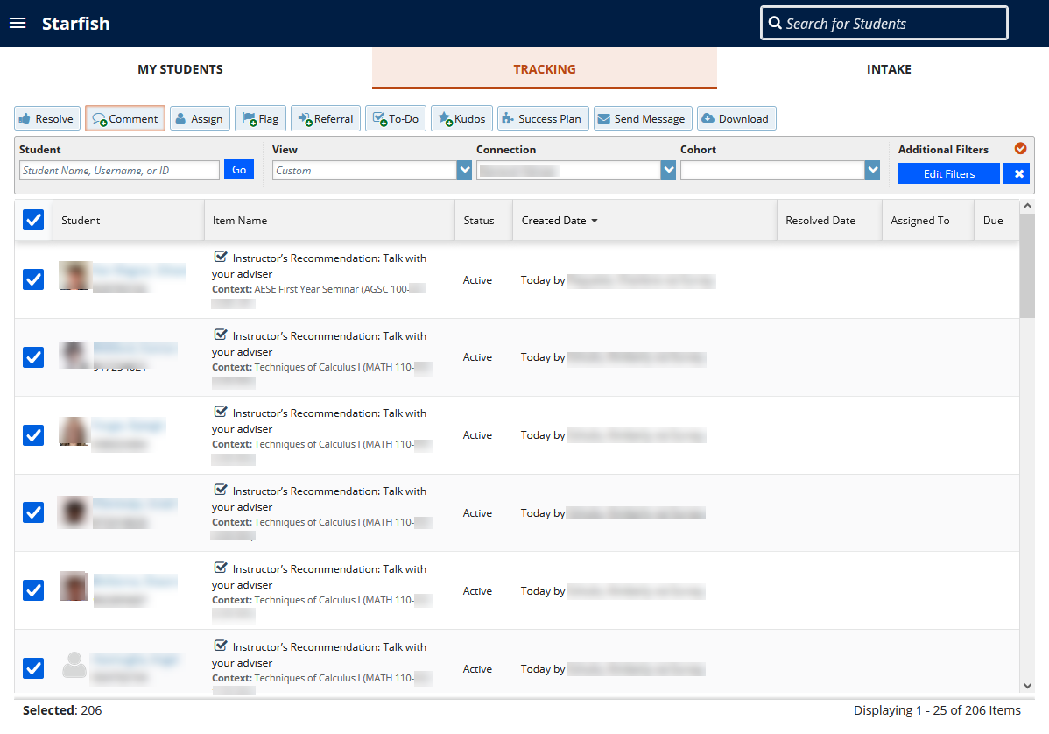
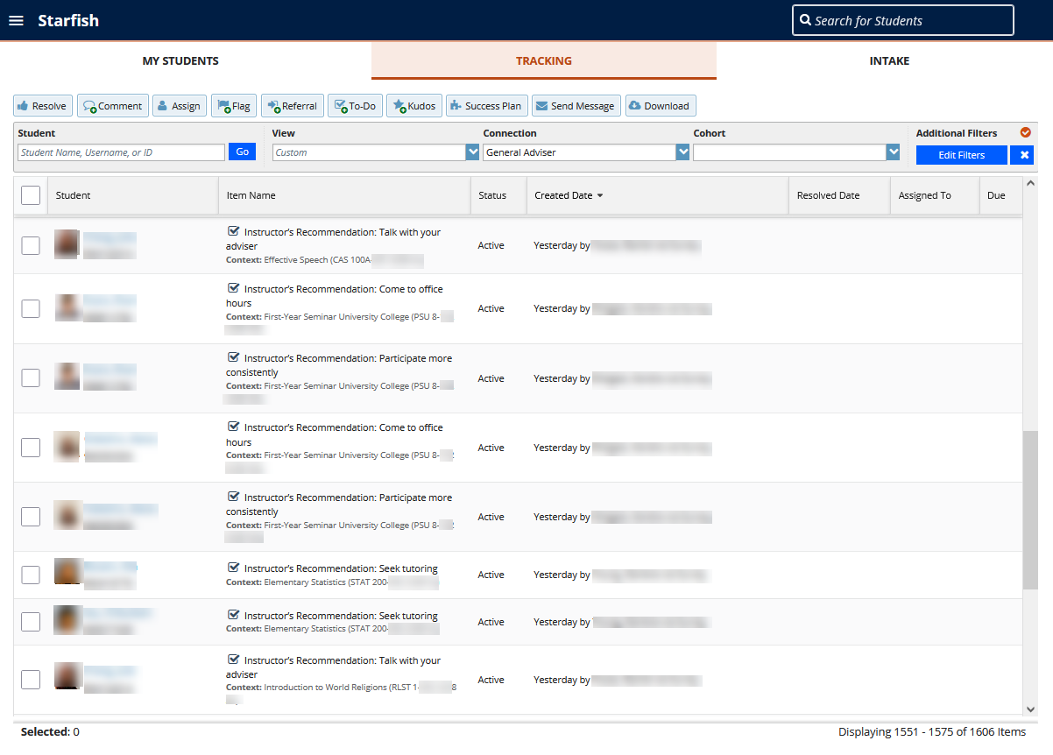
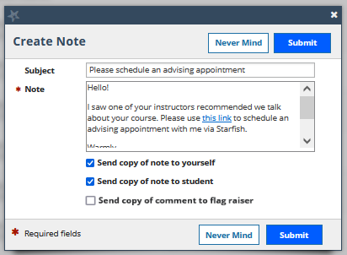
To-Dos
(To-Do) Instructor's Recommendation: Talk with your Adviser
Adviser should be available to meet with students
How?
Open advising appointments on Starfish calendar.
Comment on all advisees To-Do with link to schedule.
There are multiple To-Dos available which point students toward recommended actions.
Notes:
We encourage advisers to reach out to students for this To-Do: Instructor's Recommendation: Talk with your Adviser
1 Click.
We can filter using the Tracking tab to see all students with the To-Do. Click.
Adviser can use the Select All function to message all students. Click. We’ll review the Select All tool in just a bit.
Click to Multiple To-Dos. Advisers can also view all four To-Dos via Filters.

Slide 11
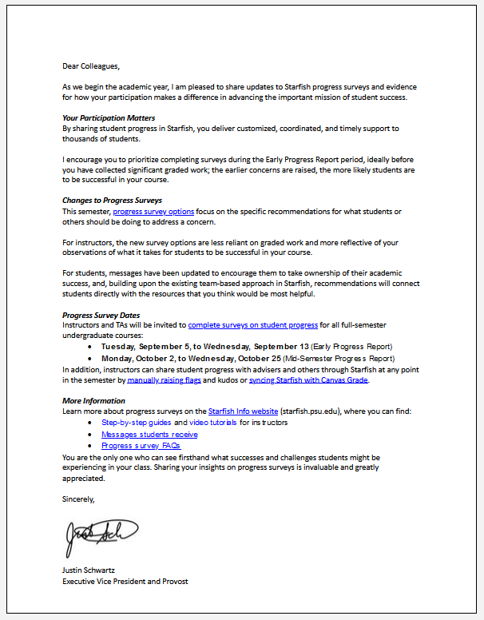
Managing Flags and To Dos
Tools at your disposal
Select all
Assign
Clear & Close the Loop
Why?
Provost’s letter
Visibility into actions of others working with students
Data collection for impact
More consistency – data to assess how adviser intervention matters
Notes:
Read slide.

Slide 12
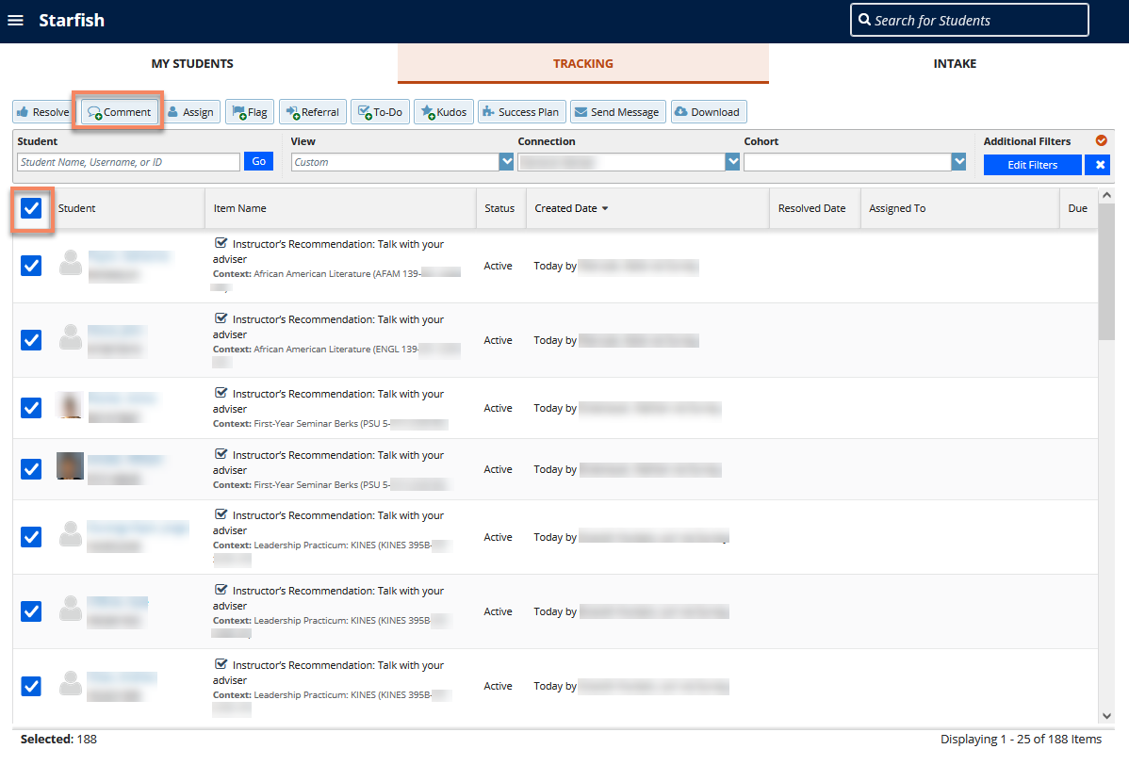
Using Select All
Select All checkbox works from all tabs
Total number of selected students on bottom of page
Perform a bulk action via buttons at the top (E.g., send comment to all To-Dos)
Resource: Knowledge Base Article: Using Select All
Notes:
From the My Students, Tracking, or Intake page, check the Select All checkbox to select all students that meet your search criteria. You'll notice at the bottom of the page the total number of students that have been selected.
Perform your bulk action such as send a message or raise a flag, etc. Keep in mind, you can only perform bulk actions based on permissions set by your Starfish Administrator.
If you have selected fewer than 50 students, the system will process your request immediately. If you have selected 50 or more students, the system processes the selection as a batch action to avoid system performance issues.
If you selected 50 or more students, you will receive the following confirmation page. Select Yes, Finish to confirm your selection.
Next, you will receive the following message indicating your batch action has been queued. This page will also give you the option to go back to the student list, review queued items on the home page, or cancel the batch send if you made a mistake.

Slide 13
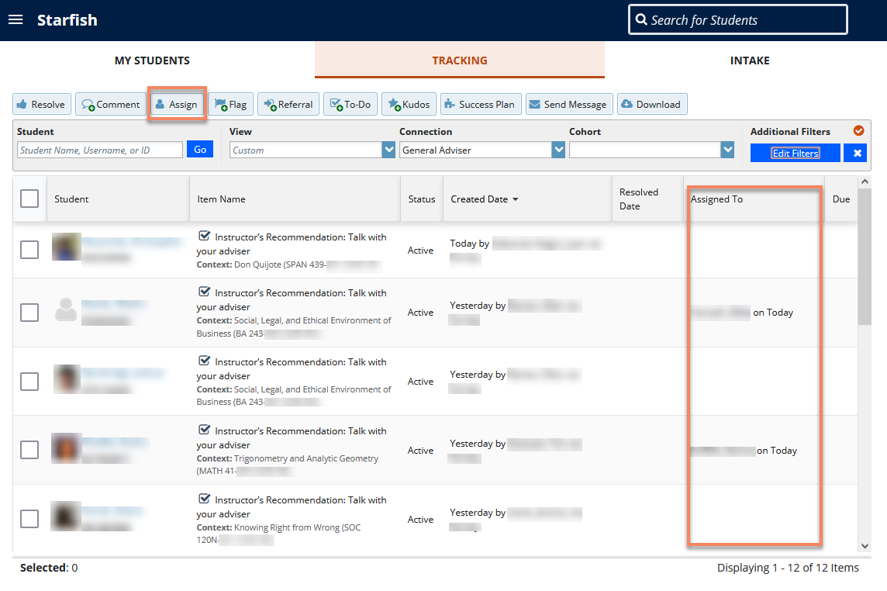
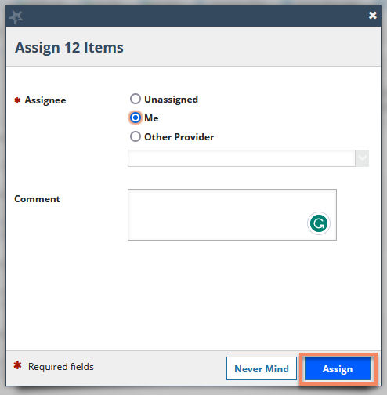
Using Assign
Once you have recorded your outreach, assign the tracking item to yourself.
This will allow you to quickly identify newly raised items and keep track of those where you have attempted additional outreach.
Resource: Knowledge Base Article: Track outreach to student's using Assign function
Notes:
Select all students from the filtered list
Click the “Assign” button
Select assign to “Me”
Click “Assign” to submit
As time goes by, additional items will come in. If you've left your filter set to show specific active items, you will be able to quickly see the newly raised flags because they are unassigned.
Refine your filter to show just unassigned flags.
Select all and repeat the outreach and assign processes detailed in the steps above.

Slide 14
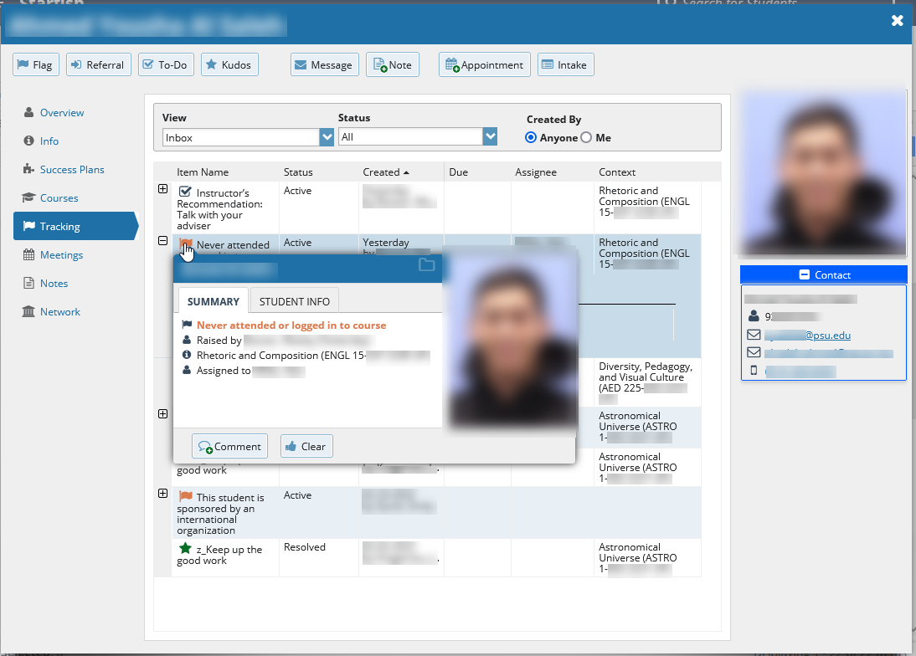
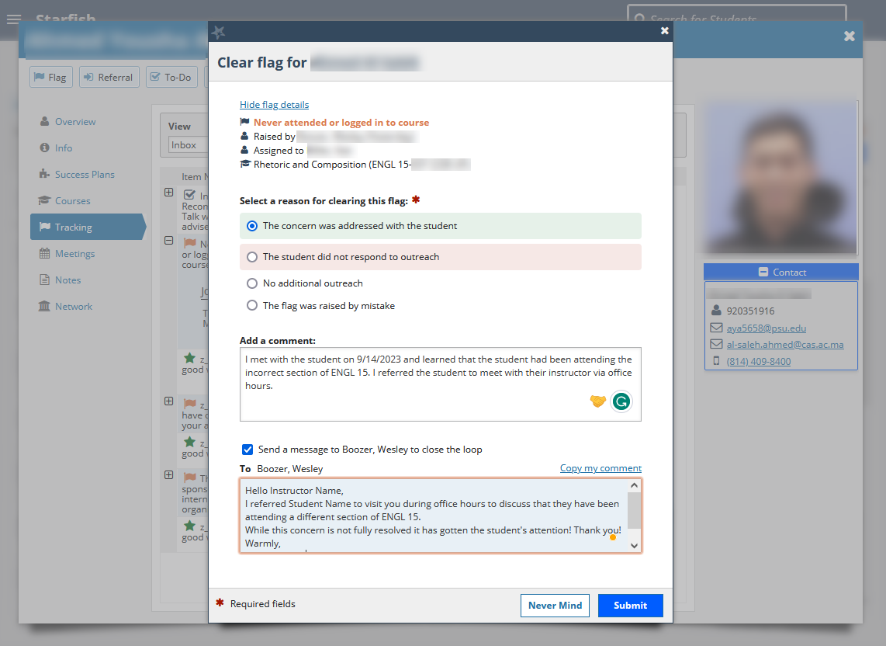
Clear & Close the Loop
As students respond and meet with you, clear the items you address.
Leave close the loop checked
Flags, kudos, to-dos and their associated comments are in the Tracking tab of each student's Starfish folder.
Resource: Knowledge Base Article: Manage Course-Based Flags and To-Dos
Notes:
As students respond and meet with you, clear the items you address.
Click on the student’s name from the roster, appointment, or search bar to open their Starfish folder.
Click on Tracking.
Note: A recommended best practice is to leave your folder view set to display both active and resolved items.
3.When you’ve discussed an issue with a student, clear all related flags or to-dos. Clearing the item does not mean the problem is fixed. Rather, it indicates that the flag or to-do did its job of prompting a conversation about steps the student plans to take moving forward.
Hover over the item's icon to bring up the dialog box.
Click “Clear.”
Select “The concern was addressed with the student.”
Add a comment that briefly summarizes the action plan. Your meeting notes will supplement this record and vice versa.
Leave the “Close the loop” checkbox selected. Starfish will notify the flag raiser that the item was addressed. Adding a custom message to the raiser lets them know there was a genuine response to their ask for assistance. Click “Copy my comment,” or add a custom message.
Flags, kudos, to-dos and their associated comments are in the Tracking tab of each student's Starfish folder.

Slide 15
Student cleared To-Dos
Two kinds:
Student closed without Review
Instructor's Recommendation: Come to office hours
Instructor's Recommendation: Participate more consistently
Instructor's Recommendation: Seek Tutoring
Student closed with Review
Instructor's Recommendation: Talk with your Adviser
Why?
Ability for students to say they did something, even if adviser doesn't interact with To-Do.
Allow adviser to confirm and to close the loop with the instructor.
Best Practice: Clear when you meet with student.
Notes:
Read Slide.

Slide 16
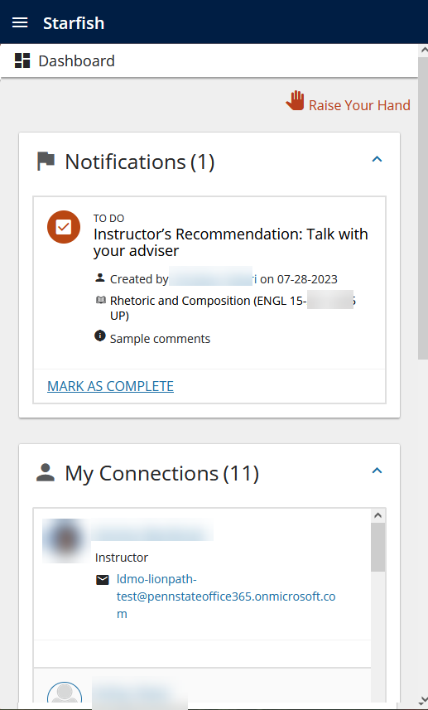
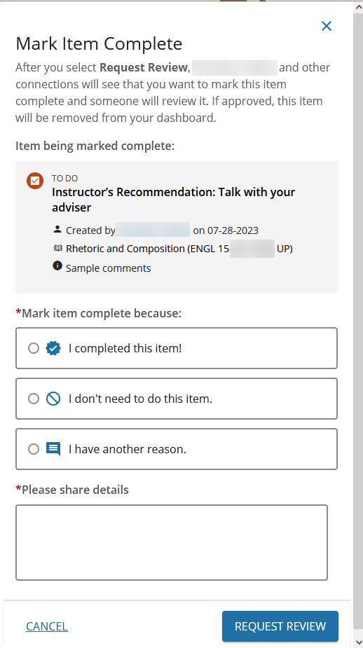
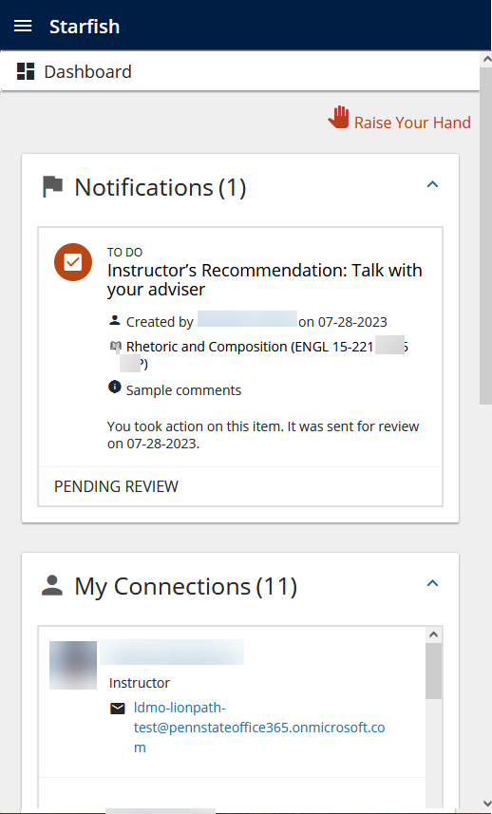
Student View: Student-closed with review
Notes:
Explain slide.

Slide 17
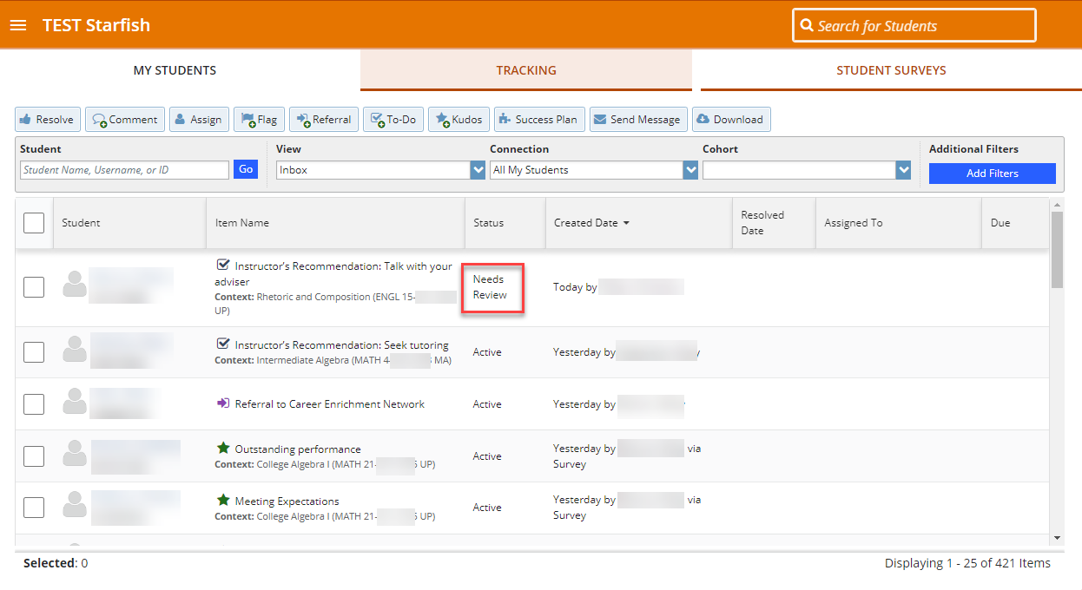
Adviser View: Student-closed with review
Notes:
Explain slide.

Slide 18
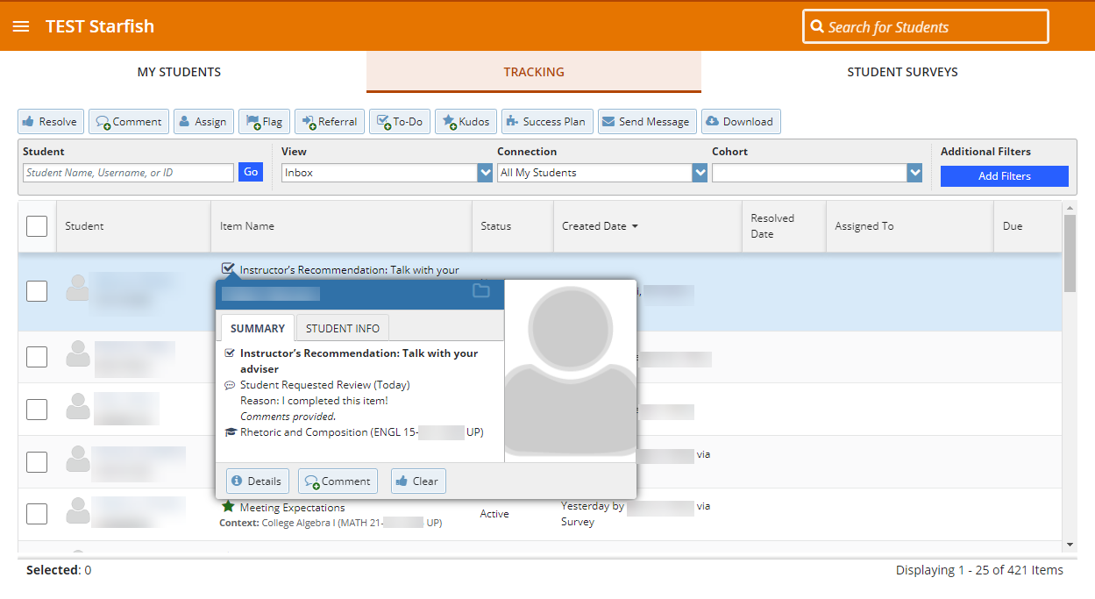
Adviser View: Student-closed with review
Notes:
Explain slide.
When you click on the To-Do tracking Item icon…

Slide 19
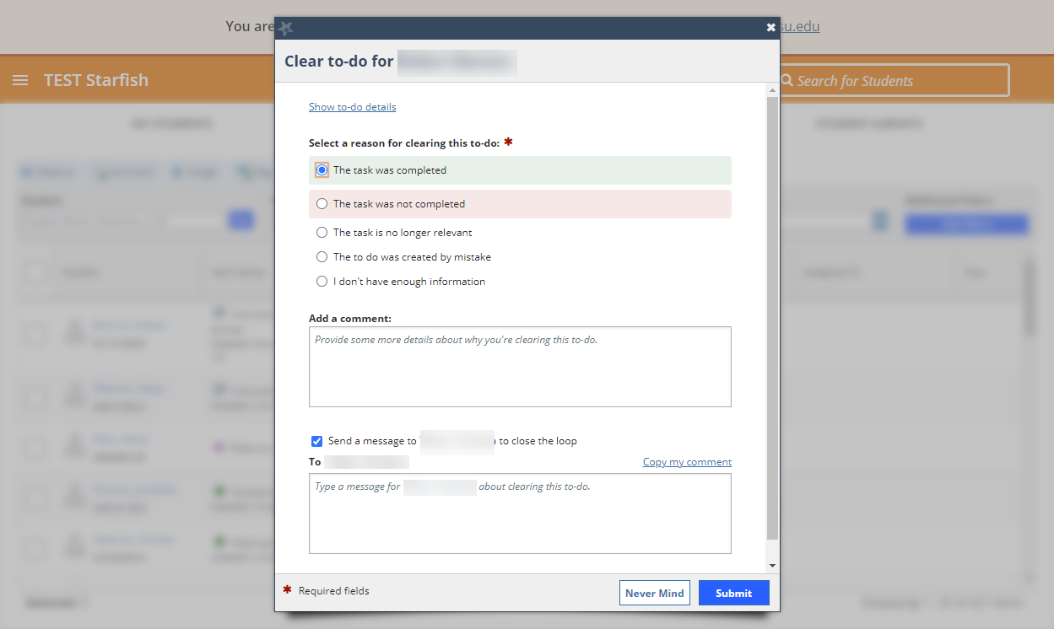
Adviser View: Student-closed with review
Notes:
Explain slide. Adviser is Clearing To-Do…

Slide 20
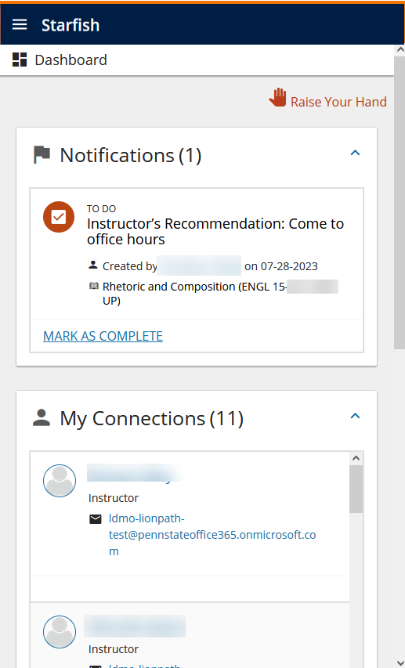
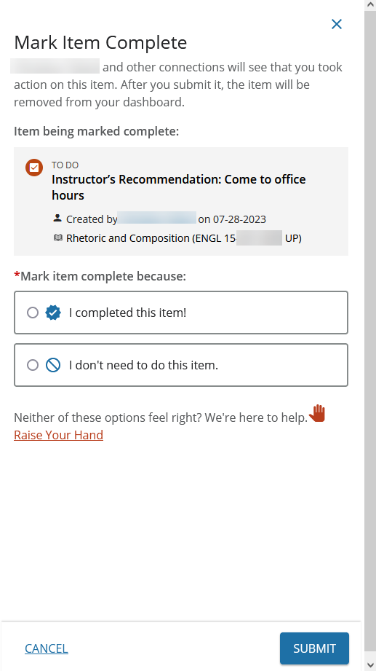
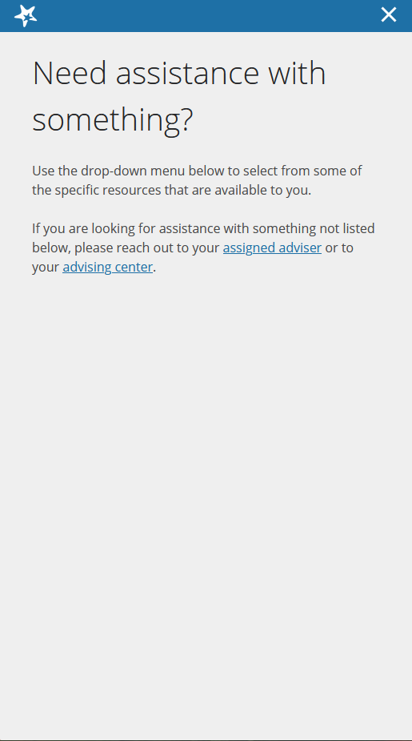
Student-closed without review
Notes:
Explain Slide.

Slide 21
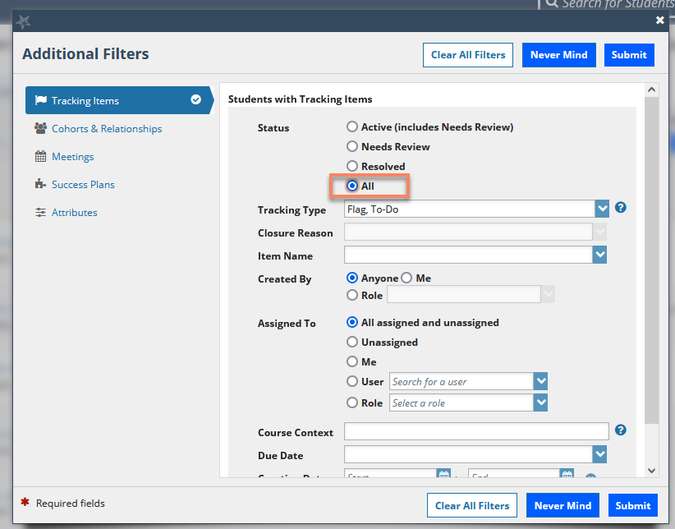
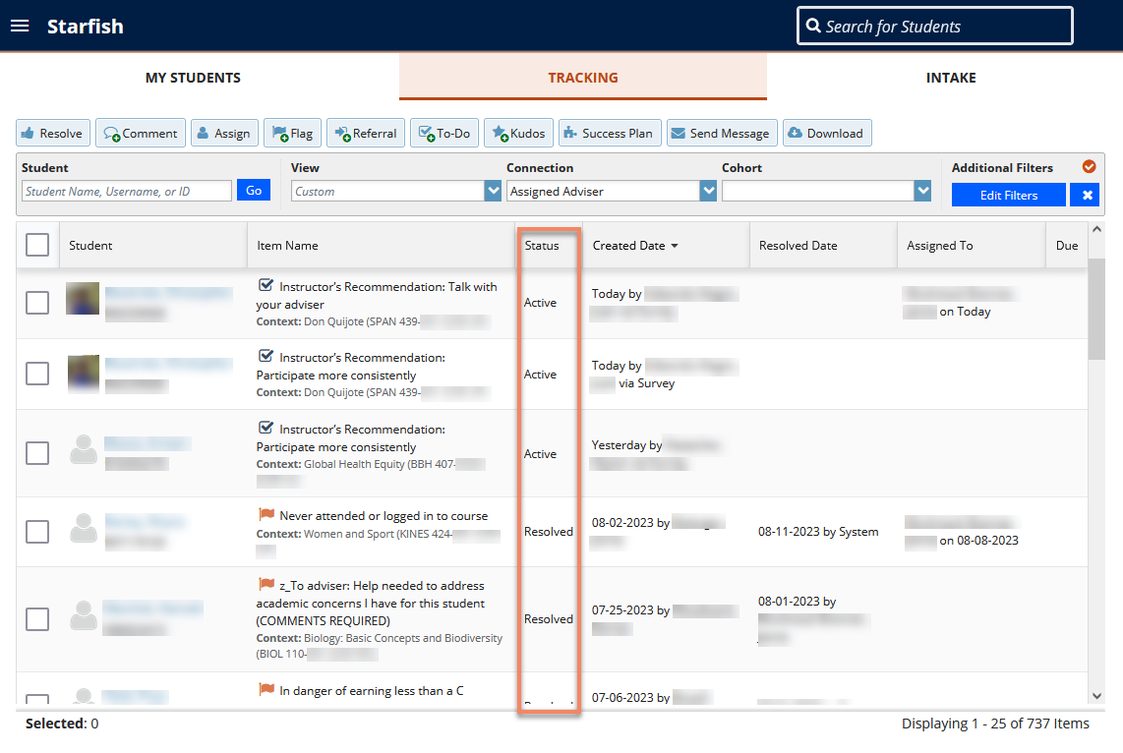
Tracking Items do not disappear
Tracking Items (Kudos, To-Dos, Flags) do not "disappear“
Active and Resolved Tracking Items are visible via Edit Filters
Notes:
Explain Slide.

Slide 22
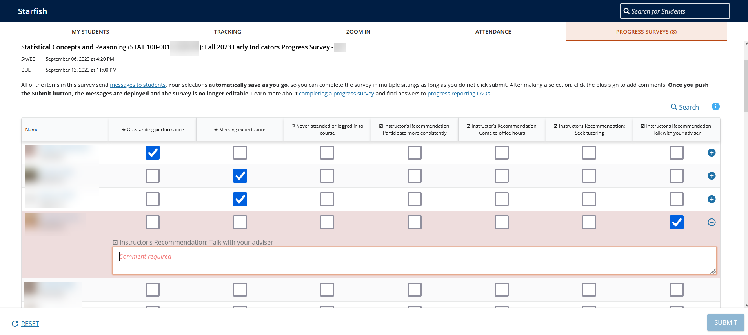
Instructor view of a Progress Survey
Comments are required to submit
… but individuals will choose what they type.
Instructor Best Practice:
Provide information for the academic adviser to discuss with the student
(We saw an example of a helpful comment earlier when we talked about multiple flags. ☺)
Resource: Knowledge Base article: See response to progress reporting
Notes:
Read Slide.

Slide 23
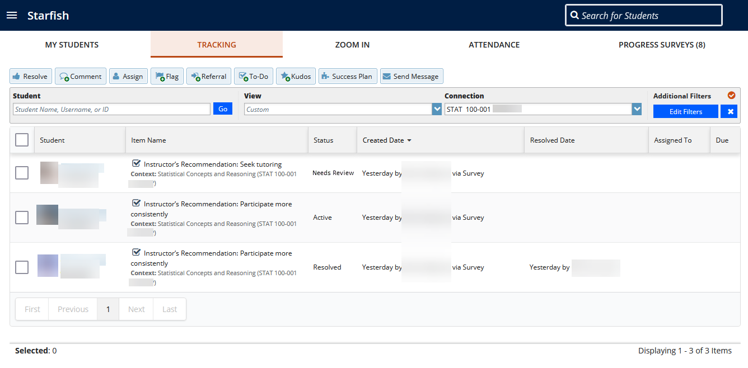
Instructor View Example: Response to To-Dos
Notes:
Instructors can see the status of a slide…

Slide 24
Documentation
Documenting student interactions allows the success network around a student to communicate efficiently.
Why?
Students know they are supported and have a network, who can connect them to further resources as needed.
Others can see prior conversations the student had regarding a Flag or To-Do.
Instructors can see how their efforts made a difference for students.
Be sure to thoughtfully consider the content of your Starfish comments.
Resource: Knowledge Base article: Ethical Guidelines for Accessing and Creating Starfish Records
Notes:
Read slide. Example at end…

Slide 25
Helpful links
FAQs for Progress Reporting: https://starfish.psu.edu/resources/faq/
Knowledge Base articles: https://pennstate.service-now.com/sp?id=kb_home
Search the term "Starfish" to filter for our articles
Notes:
Two helpful links … if you’re going to take a photo or screenshot this is the slide

Slide 26
Future presentations
Differentiated Care: Using Starfish to Provide Tiered, Holistic, and Manageable Support to Advisees: Thursday, September 21 from 11:15am – 12:15pm at 207 Penn Stater Conference Center
Elevate for Academic Advising: Thursday, October 5 from Noon – 1:00 pm via Zoom
How Elevate, a companion tool to Starfish, can help academic advisers gain insight into student’s academic engagement and focus on students who need more support.
Resource: https://dus.psu.edu/2023-dus-conference
Notes:
Differentiated Care: Using Starfish to Provide Tiered, Holistic, and Manageable Support to Advisees: Thursday, September 21 from 11:15am – 12:15pm at 207 Penn Stater Conference Center
Although all students can benefit from academic advising, different students have different advising needs. A “differentiated care” model allows academic advisers to meet the individual needs of their students while managing their rosters (and limited resources) effectively. This session will: (1) explain the principles of differentiated care, (2) provide practical examples of how support could be tiered to meet students’ needs, and (3) demonstrate how Penn State Starfish attributes, tracking items, and other datapoints can be used to better identify and support students’ holistic needs. The session will be participatory and include opportunities for participants to start planning what differentiated care might look like for them and how such a model might inform outreach strategies for the upcoming progress reporting period.
Elevate for Academic Advising: Thursday, October 5 from Noon – 1:00 pm via Zoom
How Elevate, a companion tool to Starfish, can help academic advisers gain insight into student’s academic engagement and focus on students who need more support.

Slide 27
Contact
Website: https://starfish.psu.edu
Email: starfish@psu.edu
Division of Undergraduate Studies
101 Grange Building
University Park, PA 16802-6700
814-865-7576
Notes:
"Filtering with Friends on Fridays" – John Ellenberger happy to assist those with filtering ques
Small prize to the first To-Do that Needs Review that is Resolved – JKS
Recording available on https://dus.psu.edu/academic-advising-noon-seminars-archive

