Slide 1
Religious and Spiritual Life at Penn State
Bob Smith
Director
Center for Spiritual and Ethical Development

Slide 2
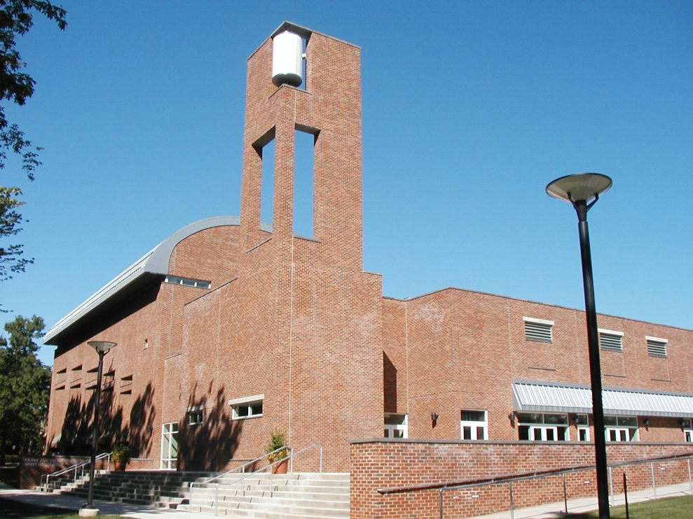
Center for Spiritual and Ethical Development (CSED)
More than 60 RSO’s
Services
Programs and events
Weddings
Memorial services
Advocacy
Collaboration
Odds and ends
Holiday calendar

Slide 3
Is There Someone There I Can Talk To?
Pastoral counseling
CSED staff
Most common: Looking for a group
I’m converting and don’t know how to tell my parents
Mental health issues: CAPS
We care!

Slide 4
How Do You Get Away With This?
With what?
“Separation of church and state”
No money from the university
Not establishing religion
No mandatory attendance
No preferential treatment
Not interfering with the practice of religion

Slide 5
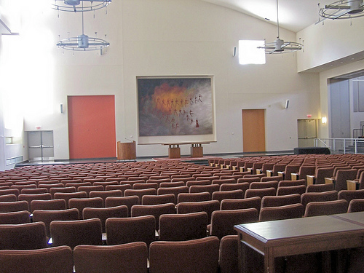
Does It Matter?
Higher satisfaction
Higher retention
Lower risk of alcohol abuse
Greater sense of community
More resources
Less likely to be sent to the Office of Student Conduct

Slide 6
Trends
Participation in organized religion decreasing
Participation in spiritual practices increasing
Islam – by 2050 is projected to be the largest religion
Atheism/Agnosticism increasing
At Penn State there has been growth in two religions: Islam and Latter Day Saints (Mormons)
Trump presidency – Executive orders, Islamophobia, antisemitism

Slide 7
IDEALS Survey
Institutional Diversity Experiences & Attitudes Longitudinal Study
Interfaith Youth Core (IFYC)
Religious & spiritual – 39.0%
Religious, not spiritual – 15.7%
Spiritual, not religious – 22.5%
Neither – 22.8%

Slide 8
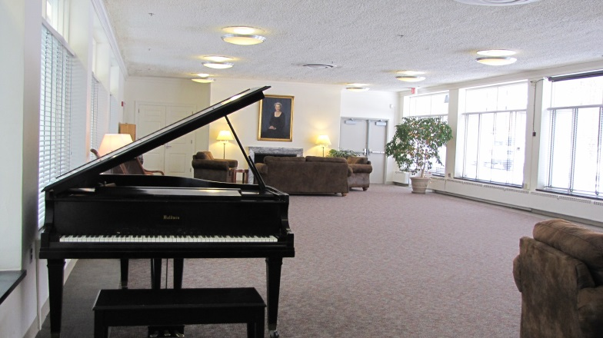
What Do Our Students Think?
Positive contributions to society: Buddhists the most and Mormons the least
Ethical: Buddhists highest and Atheists lowest
Things in common with: Jews highest, Mormons lowest
World can overcome problems if religions work together: 82.68%

Slide 9
You May Want To Know
Muslims – safe on campus but see media bias
Antisemitism
Suspicion – especially of evangelical Christians
Pagan/Wiccan – not devil worship
But, they’re a religious group…
Don’t be afraid to ask
Celebrate – don’t hide
Just show you care – take an interest!

Slide 10
Questions
Contact: rhs13@psu.edu or 814-865-6548

